Slide 1

BAREJA TERMINAL OPERATION
Presented By,
Sanjiv Ranjan
Samir Kumar Nayak
Sadiq Syed
Tuneer Bhattacherjee
Sahil Hansraj Nagrale
Sagar Singh Rathore
Anurag Gupta
Supandeep Grewal
Saurabh Dubey

Slide 2



Overview
Receipt
Storage
Quality
Dispatch
RECEIPT
QUALITY
OPERATIONS IN BAREJA TERMINAL
DISPATCH
STORAGE

Slide 3
Overview
Receipt
Storage
Quality
Dispatch
Reciept
1.KSPL
Multi-product pipeline
Ahmedabad ToP
2.KAPL
Dedeicated pipeline for ATF
Supplies to whole Gujraat, touches few places in Rajsthan.

Slide 4
Overview
Receipt
Storage
Quality
Dispatch
INTERFACE CUTTING
Done by pipeline division at exchange pit
MS
PCK
SKO
PCK
HSD
PCK
MS
2% OF SKO
+
2% OF MS
2% OF HSD
+
2% OF SKO
2% OF MS
+
2% OF HSD

Slide 5
Overview
Receipt
Quality
Storage
Dispatch
Storage Tank Farm
2A
3B
4D
4C
WATER
TANKS
5A
2B
3A
4A
4B
5B
SKO/ATF
HSD
ETHANOL
5C
1C
1B
1A
6A
6B
MS
UG & HZ

Slide 6
Overview
Receipt
Quality
Storage
Dispatch
Tank Capacities & Storing Limit
Types of tanks
Tanks are classified in the three ways:
Under ground and above ground tanks.
Floating roof and cone roof tanks.
Horizontal and vertical tanks.
For MS floating roof tanks are used to prevent evaporation.
Floating roof locks down at 1.25 meter.
Storage Tank | Quantity | Level Filled | Tank Dia.
MS | 3 | 8300KL | 24M
HSD | 4 | 11000KL | 32M
ATF | 2 | 6300KL | 28M
SKO | 2 | 3300KL | 18M
ETHANOL | 2 | 70KL
WATER | 3 | 2600KL/ 5200KL

Slide 7
Overview
Receipt
Quality
Storage
Dispatch
Mode of Tanks
Receipt
Dispatch
Dormant
Opened
Closed
Closed
Opened
Closed
Closed
Product is being received either from Pipeline or other Tanks.
No Dispatch occurs during this period.
Product is dispatched to TLF or other Tanks.
No receiving Operation occurs during this period.
Tank is Ideal. No dispatch or receiving is done.
Due to maintenance or other reasons.

Slide 8
Overview
Receipt
Quality
Storage
Dispatch
Tank Level Alarms while storing
Tank level Warning.
Tank level Warning.
While Receiving Product
While Dispatching Product
Tank level crossed permissible limit.
Receipt Valve is Closed.
Dispatch Valve is Closed.
Tank Level below permissible limit.
H
L
Critical Height reached.
Emergency Shutdown occurs.
Critical level reached.
Emergency Shutdown occurs.
HH
LL
HHH
LLL

Slide 9
Overview
Receipt
Quality
Storage
Dispatch
Storage Tank Pipe Valves
TANK
Primary Valve Inlet
Primary Valve Outlet
DBBV
DBBV
ROSOV
ROSOV
Secondary Valve Outlet

Slide 10
Overview
Receipt
Quality
Storage
Dispatch
Quality and Quantity at Different Stages
Marketing Acknowledgement
TLF Quality Checks
Refinery
Guaging of tanks
Valve checks
Acknowledgement to pipeline
Density Test
Water Test
Sedimentary Test
Receive the test reports
Quantity
Pipeline
Batch Formation Test
Consumer End Checks
Valve Checks
Inform Terminal about the receipt
Settling in storage
Sampling
Tests report generated
Density Test
Surprise Test
Sample for MDG

Slide 11
Overview
Receipt
Quality
Storage
Dispatch
Batch Formation Test
TLF Checks
Density Checks
Water Checks
Sedimentary Checks
Dip Checks
MS should be in the first compartment
ATF
Settling time of two hours
Sample from Upper, Lower and Middle
21 different tests are performed
Tests are carried Monthly, weekly and MDG
Test reports are issued to Control Room
Every TT carries the test report
MS, HSD, SKO
Standard Measure
Settling time of one hour
Sample from Top, Bottom and Middle
9 different tests are performed
Density, Distillation, Sulphur, Copper, ROE, Appearance, Color, RON
Tests are carried Monthly, weekly and MDG
Test reports are issued to Control Room
Flash Points
SKO & HSD –> Minimum 35 Degree Celsius
ATF –> Minimum 38 Degree Celsius
Density
HSD –> 815 – 845 kg/m3
ATF –> 775 - 840 kg/m3
MS –>720 – 775 kg/m3

Slide 12







Overview
Receipt
Storage
Quality
Dispatch
Type of Customers
Dispatch is done through Tank Trucks
Priority of the Customer
Consumer Sales
Dealer Owned
Transporter
Priority Dealers
Retail Outlets
Consortium
Demand Sensing
Through SMS
Through Xsparsh Web Application
Tankers are epicoated to prevent any chemical reaction
ATF has dedicated TT’s
COCO
Consumers - Bulk
Non Priority Dealers

Slide 13
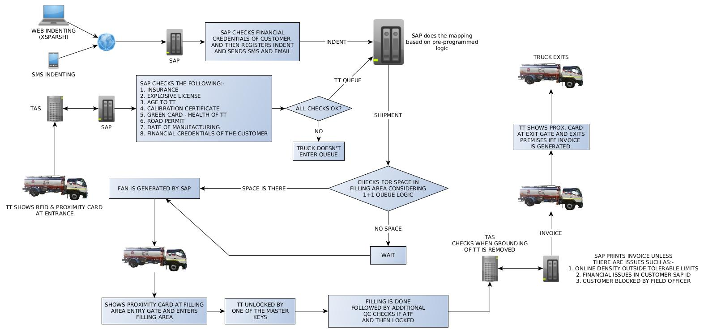
Overview
Receipt
Storage
Quality
Dispatch
Dispatch of TT

Slide 14
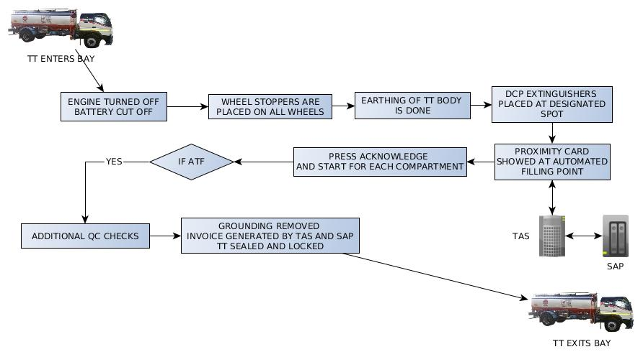
Overview
Receipt
Storage
Quality
Dispatch
TLF Flow

Slide 15



